Slide 1
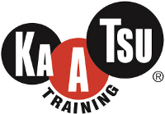
3 Case Studies with KAATSU?
Dr. Jim Stray-Gundersen, MD
Chief Medical Officer
KAATSU Global

Slide 2
Todd Lodwick
37 y/o, 6-time Nordic Combined Olympian
January 3rd 2014 won National Championship, qualifying for 6th Olympic Games.
January 10th 2014 Fell ski jumping, multiple comminuted fracture of L humerus, labral tear, disrupted rotator cuff, broken rib.
Challenge: maintain fitness and heal L shoulder sufficiently to meaningfully compete in 2014 Sochi Olympic Games (Opening Ceremonies February 7th ).
On January 13th, initiated normal KAATSU Training on 3 uninjured extremities and modified KAATSU Cycle and Training on L arm, 2X/day.
In addition to KAATSU, uphill treadmill walking, rollerskiing with one pole, stationary cycling.

Slide 3
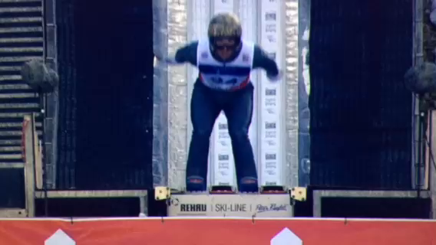
Todd’s Injury 1/10/14

Slide 4
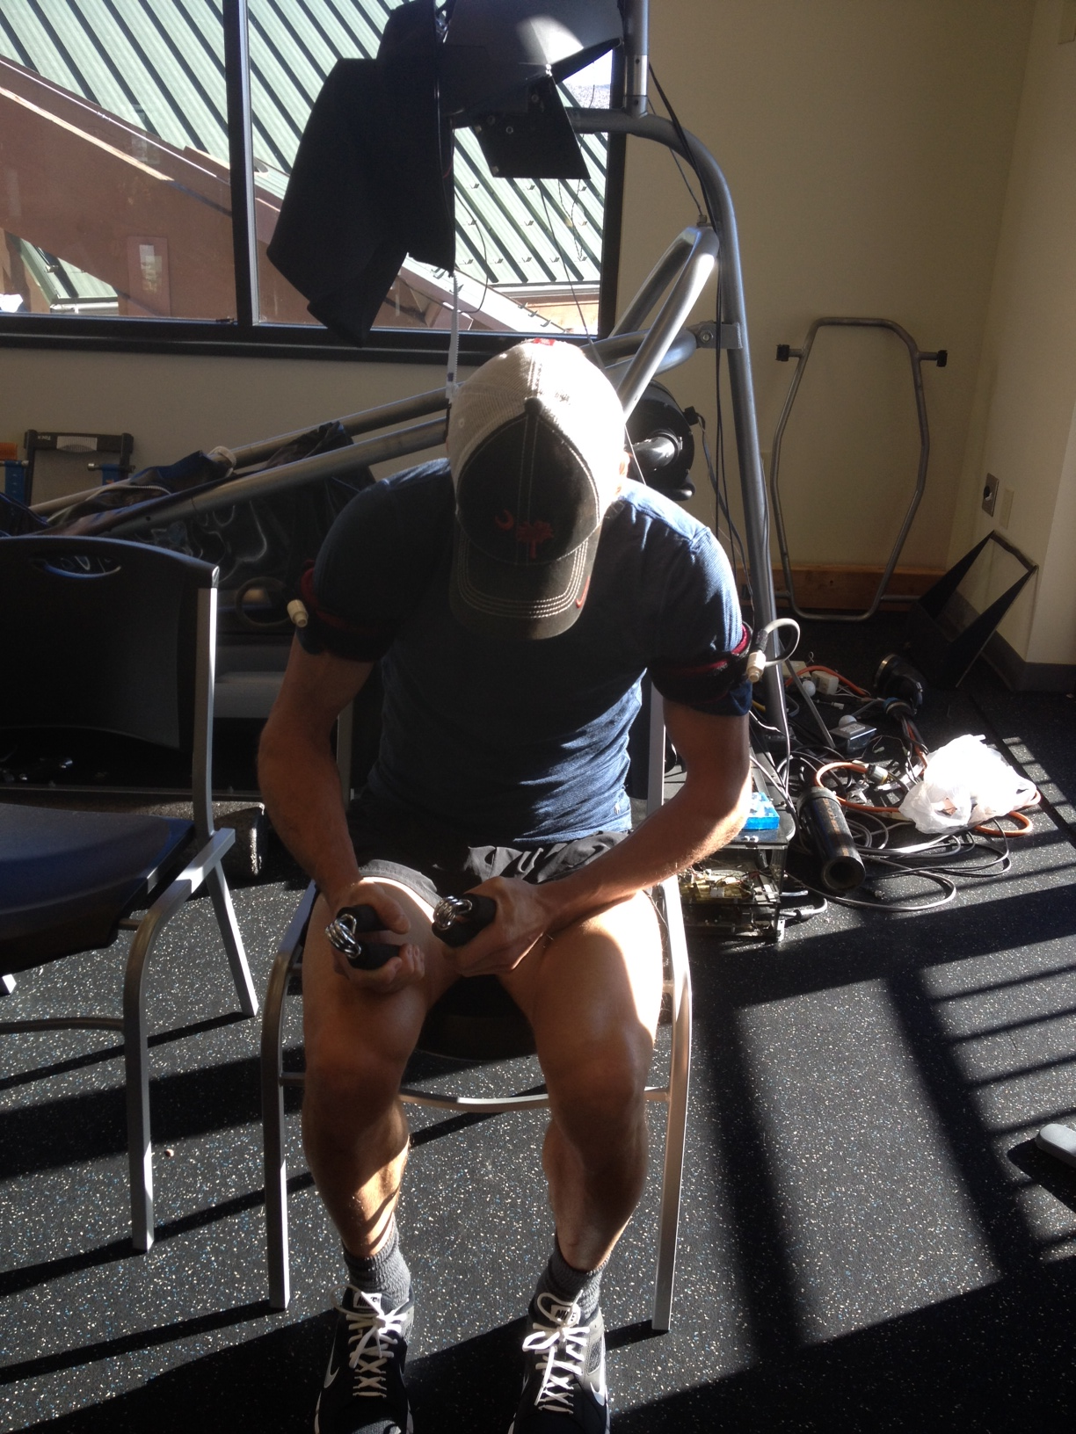
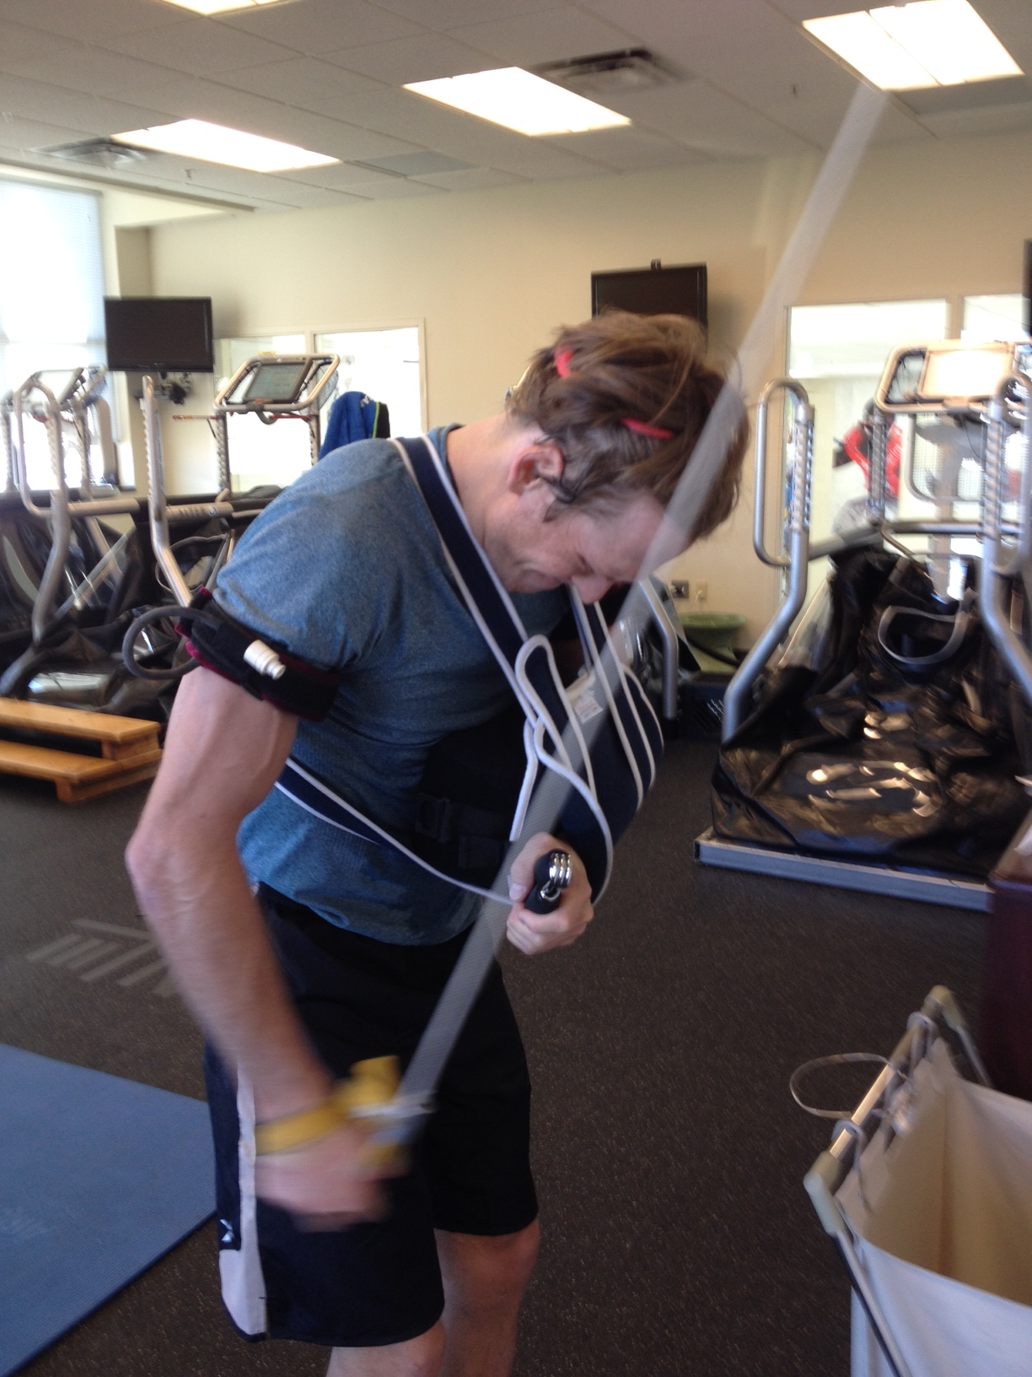

Slide 5
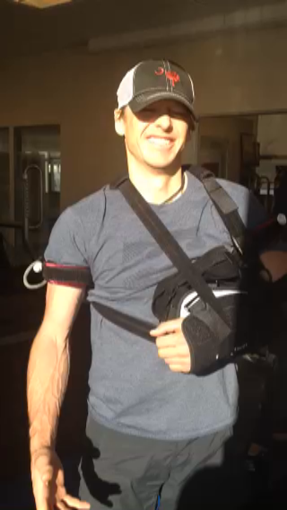
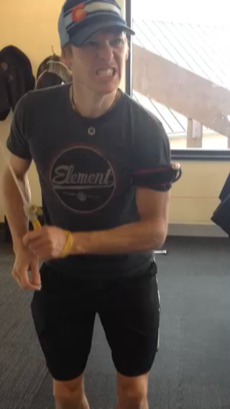
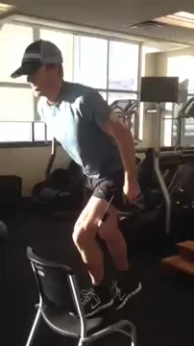

Slide 6
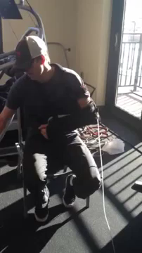
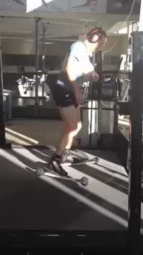

Slide 7
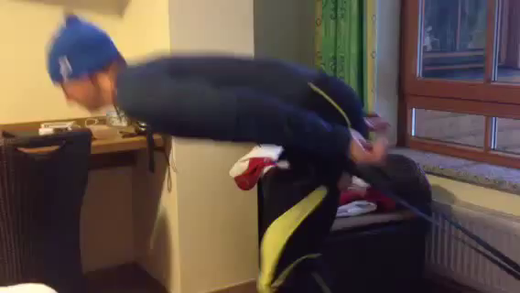

Slide 8
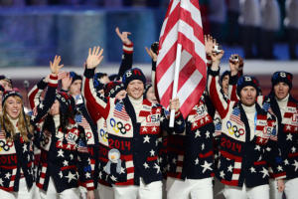
USA Flag bearer
Note: carrying flag in Left hand 4 weeks post injury

Slide 9
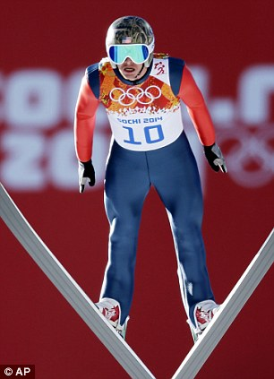
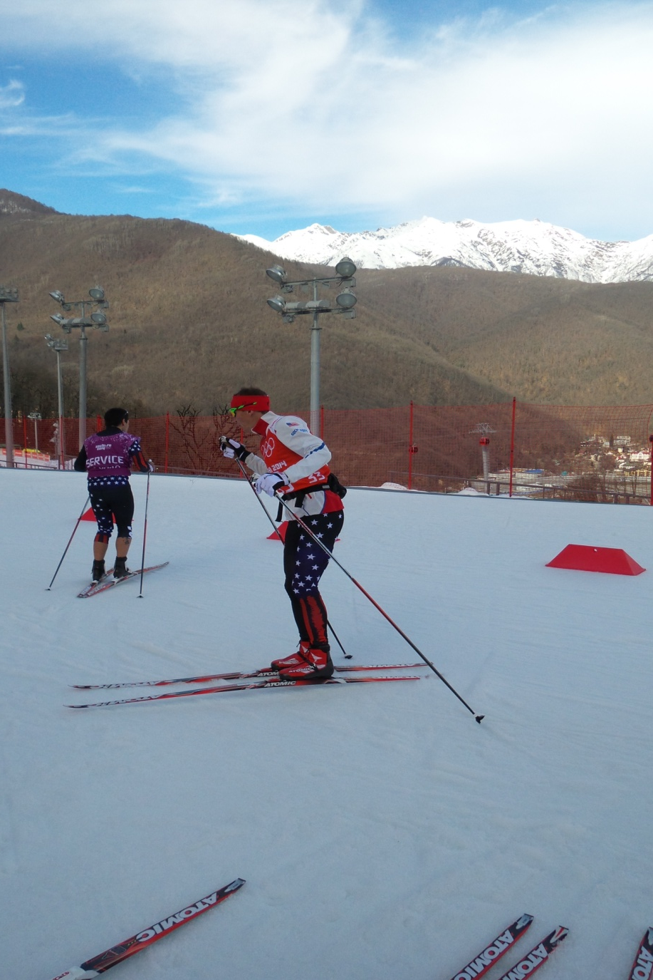
Olympic Team Event 40 days post injury

Slide 10
Todd Lodwick
37 y/o, 6 time Nordic Combined Olympian
Jan 28th, first run down landing hill; first cross country skiing.
Feb 7th, carried US flag in Opening Ceremonies
Feb 10th, first ski jumping practice, normal hill
Feb 13th, first XC interval session
Feb 20th, Olympic NC Team competition (40 days post injury).
  Normal, expected jumping performance
  95% typical performance in 5 km XC skiing (12:28)
  Team finished respectable 6th place.

Slide 11
Bode Miller
36 y/o Olympic and World Champion Alpine Racer
Bronze medal Super G, Sochi Olympic Games Feb 2014
Chronic back and knee pain preventing normal training in the summer and fall of 2014.
Oct. -> Introduction to KAATSU Training
Dec. -> Micro disectomy L4-L5
Post Op: KAATSU Training twice per day.
In late Dec/Jan, some easy alpine skiing plus a few training runs on race courses.
Feb 9th Super G Competition, Vail World Championships.
Result: crash and DNF. However, skiing really well and leading the race at the time, likely medal performance, possibly gold. Two severe lacerations to back of knee and gastrocnemius preventing further competition.

Slide 12
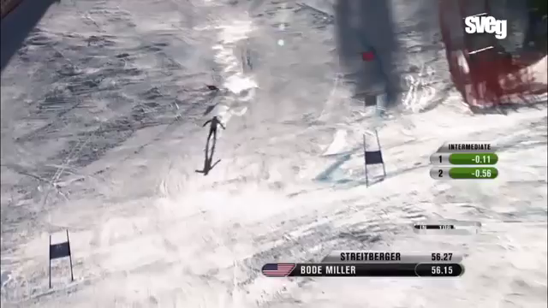
Bode Miller
Olympic and World Champion Alpine Racer
file:///.file/id=6571367.3079744

Slide 13
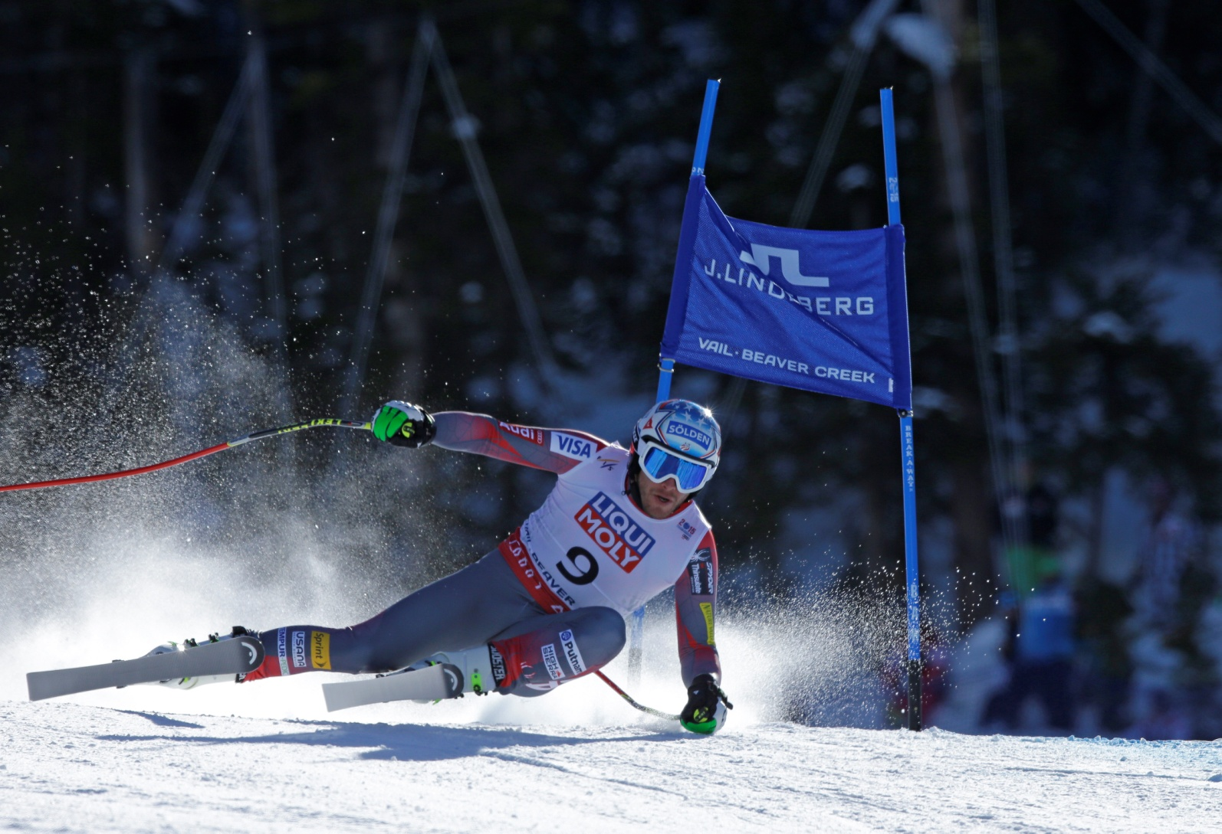
Bode, Super G, Vail 2015
2 months post op microdisectomy

Slide 14
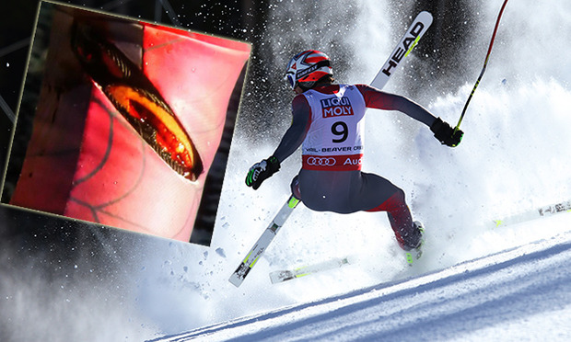
Bode, Super G, Vail 2015 lacerated semi-tendinosis

Slide 15
Josh Saunders
32 y/o Keeper for
LA Galaxy, Real Salt Lake and NYCFC
July 13 2013: Tore L ACL during a match
July 23, 2013: L ACL reconstruction using L hamstring graft.
Aug 3, 4, 7th ‘13 Graft/joint/bone infection requiring multiple re-operation, graft removal, debridement and long term antibiotic treatment.
Due to disuse, infection and multiple surgical procedures, quadriceps and associated musculature were markedly atrophied.
Sept 13, ‘13 Started Alter-G and KAATSU training daily.
Oct 15, ’13 Re-operated, bone graft used for sealing previous canals.

Slide 16
Josh Saunders
Keeper for LA Galaxy, Real Salt Lake and NYCFC
Jan 6th, ‘14 L ACL reconstruction with R hamstring graft.
Alter-G and KAATSU protocols re-started within first post-op week.
12 weeks post-op; gait, girth and strength of quadriceps normal and symmetric to contra-lateral side. Instituted drills on the pitch.
18-24 weeks. Return to normal training/practice.
First game, 23 weeks post op.
March ’15 MLS player of the month

Slide 17
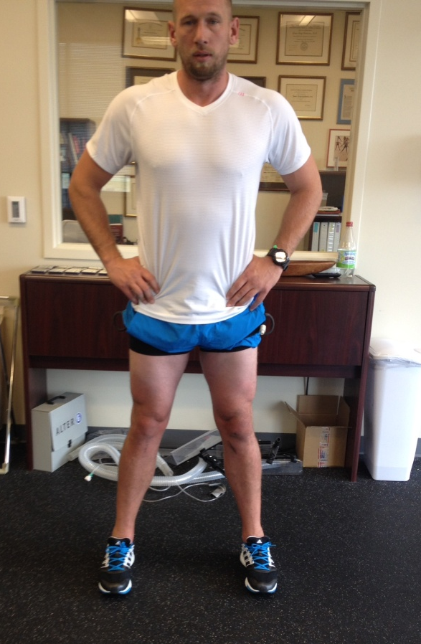
Josh 8 weeks post L ACL repair
Equal quad girths

Slide 18
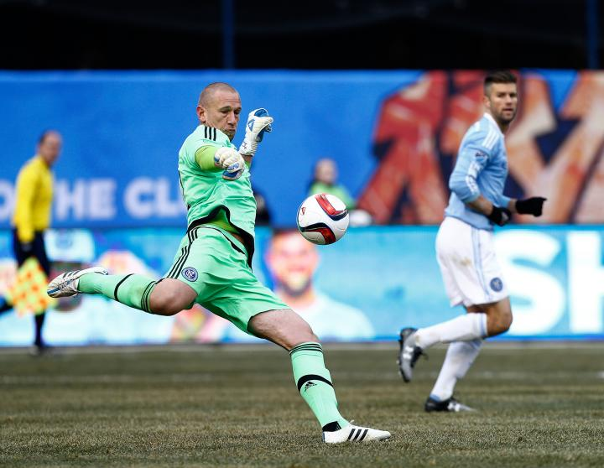
Josh Saunders keeping goal

Slide 19
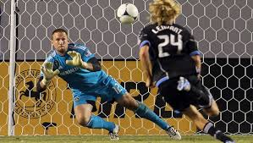
Josh Saunders, 100% rehabilitated
1 year post
L ACL repair

Slide 20
Conclusion of Case Reports
In all 3 cases, KAATSU Cycle and Training were the primary and critical rehabilitation tool in returning these elite athletes to their sport.
In all 3 cases, the athletes were competing much earlier than expected.
In all 3 cases, the whole athlete was re-conditioned for the demands of their sport, with minimal loss of fitness.

Slide 21
Conclusions
KAATSU is safe, when proper equipment is used and Dr. Sato’s protocols are properly applied.
KAATSU is efficacious at:
  Building strength with short workouts (30 minutes) and in as few as 10 sessions.
  Improving performance where specific strength is a critical parameter
KAATSU accelerates return to sport.

Slide 22
Conclusions
KAATSU simply tricks the brain into thinking a huge, horrendous workout has occurred and it must repair the damage, where in reality, little damage has been done and rebuilding just makes structure and function better rapidly.
KAATSU allows significant maximal intensity training while injured joints, bones, and muscles heal expediously.

Slide 23
When KAATSU is used with Dr. Sato’s equipment and protocols
A safe, effective, efficient method for improving specific strength in sport, leading to improved performance on the pitch.
A safe, effective, efficient method to return an injured player back to the pitch quickly.
A safe, effective, efficient method for stimulating recovery.

